Slide 1
Introduction to HTML

Slide 2
HTML
HTML stands for Hyper Text Markup Language is the language of web pages (pages end with “.htm” or “.html”) on the world wide web. HTML is easy to learn, using which you can create your Website.

Slide 3
History
1991
HTML first published
1995
HTML 2.0
After HTML 4.01 was released, focus shifted to XHTML and its stricter standards.
1997
HTML 3.2
1999
HTML 4.01
XHTML 2.0 had even stricter standards than 1.0, rejecting web pages that did not comply. It fell out of favor gradually and was abandoned completely in 2009.
2000
XHTML 1.0
2002 -2009
HTML5 is much more tolerant and can handle markup from all the prior versions.
XHTML 2.0
HTML5
Though HTML5 was published officially in 2012, it has been in development since 2004.
2012
No browsers have full HTML5 support. It will be many years – perhaps not until 2018 or later - before being fully defined and supported.

Slide 4
What is a Tag
Tags are “Normal text” surrounded by bracketed “< >” tags that tell browsers how to display web pages.

Slide 5
Important things about Tags
HTML is a tag-based programming language.
Usually paired: <TITLE>My Web Page</TITLE>
Not case sensitive: <TITLE> = <title> = <TITLE> | small letters is preferred
Opening tag and closing tag - <html> </html>
Self closing tag <br>
Common tags are: <html>, <head>, <h1>, <p> and more
Web browsers never display tag syntax

Slide 6
Important Terms
Browser – A software program which is used to show web pages. Common example is “Google Chrome”.
URL – Uniform Resource Locator. Is the location of any website or webpage like https://www.google.com.
WWW –The World Wide Web, commonly known as the Web, is an information system where documents and other web resources are identified by Uniform Resource Locators, which may be interlinked by hyperlinks, and are accessible over the Internet.
Hyperlink – hyperlink is the linked text, image, video or any other object that redirects the user to the targeted location which can be a website, webpage, email, phone number, downloadable file, music, video or more.

Slide 7
Website
Website is a collection of Webpages

Slide 8
Types of Websites
Static
Dynamic

Slide 9
Component of Dynamic Website or WebApp apart from Devops
Front End
HTML
Backend
Node
MySQL
CSS
Java Script
Angular
React js
PHP
Java
Next
Angular
Python
Microsoft SQL Server
Mongodb
MariaDB
Oracle
PostgreSQL
Cassandra
Vue
Sass
Bootstrap
ASP.Net
Ruby
Database

Slide 10
Editor
There are many different programs that you can use to create web documents.
These programs will generate the HTML web page for you.
For Microsoft Windows default text editor is Notepad, whereas, for Mac, it is Textpad.
Editors are software that assist user to create a web page easily and effectively.

Slide 11
HTML Editor
Notepad++
Sublime
Atom
Brackets
Visual studio code
Some of the popular IDE (Integrated development environment) / editors

Slide 12
HTML Page Creation
Hello World Program

Slide 13
Let’s Understand the Structure
<html>
<head>
<title>My Webpage</title>
</head>
<body>
<h1>Hello World</h1>
</body>
</html>

Slide 14
Explanation
The whole web page is divided into two major parts.
The <head> and the <body>. Head tag of your document point to the initial part of your webpage whereas, attributes of the Body tag control document properties. The BODY element of a web page is an important element regarding the page’s appearance.
The < Title> tag is for the Page Title of your document, and it appears in the very top line of the user's browser. If the user chooses to "Bookmark" your page or save it as a "Favorite", this TITLE is added to the Bookmark's list.
The text in your TITLE should be as descriptive as possible because this is what many search engines on the internet use for indexing your site.
Keep your Title precise under 65 characters or so as it is the recommended size by search engines.
The <h1> is one of the mot important tag stands for Heading 1. This tag inform search engines about the content for the webpage.

Slide 15
Headings: <Hx> </Hx>
Inside the BODY element, heading elements H1 through H6 are generally used for major divisions of the document.
Headings are permitted to appear in any order, but you will obtain the best results when your documents are displayed in a browser if you follow these guidelines:
H1: should be used as the highest level of heading, H2 as the next highest, and so forth.
You should not skip heading levels: e.g., an H3 should not appear after an H1, unless there is an H2 between them.

Slide 16
Heading Example
<HTML>
<HEAD>
<TITLE> Example Page</TITLE>
</HEAD>
<BODY>
<H1> Heading 1 </H1>
<H2> Heading 2 </H2>
<H3> Heading 3 </H3>
<H4> Heading 4 </H4>
<H5> Heading 5 </H5>
<H6> Heading 6 </H6>
</BODY>
</HTML>
Heading 1
Heading 2
Heading 3
Heading 4
Heading 5
Heading 6
HTML
Outcome

Slide 17
Decorators
<P> <FONT SIZE=“+1”> One Size Larger </FONT>
<FONT SIZE=“-1”> One Size Smaller </FONT> <BR>
<B> Bold</B>
<I> italics</I>
<U> Underlined </U>
<FONT COLOR=“#FF0000”> Coloured </FONT>
<EM> Emphasized</EM>
<STRONG> Strong </STRONG>
<TT> Tele Type </TT>
<STRIKE> strike-through text</STRIKE>
DEL is used for STRIKE at the latest browsers
<BIG> places text in a big font</BIG>
<SMALL> places text in a small font</SMALL>
<SUB> subscript position </SUB>
<SUP> superscript style position </SUP>

Slide 18
Containers
Division
Represents a division in the document and can contain most other element type.
<DIV></DIV>
Tabular Format
<TABLE>
<tr><td>R1-C1</td><td>R1-C2</td></tr>
<tr><td>R2-C1</td><td>R2-C2</td></tr>
<tr><td>R3-C1</td><td>R3-C2</td></tr>
</TABLE>

Slide 19
Table
<table border=“1”>
<tr>
<th> Column 1 header </th>
<th> Column 2 header </th>
</tr>
<tr>
<td> Row1, Col1 </td>
<td> Row1, Col2 </td>
</tr>
<tr>
<td> Row2, Col1 </td>
<td> Row2, Col2 </td>
</tr>
</table>

Slide 20
<table border=1 cellpadding =2>
<tr>
<th> Column 1 Header</th> <th> Column 2 Header</th>
</tr>
<tr>
<td colspan=2> Row 1 Col 1</td>
</tr>
<tr>
<td rowspan=2>Row 2 Col 1</td> <td> Row 2 Col2</td> </tr>
<tr>
<td> Row 3 Col2</td>
</tr>
</table>

Slide 21
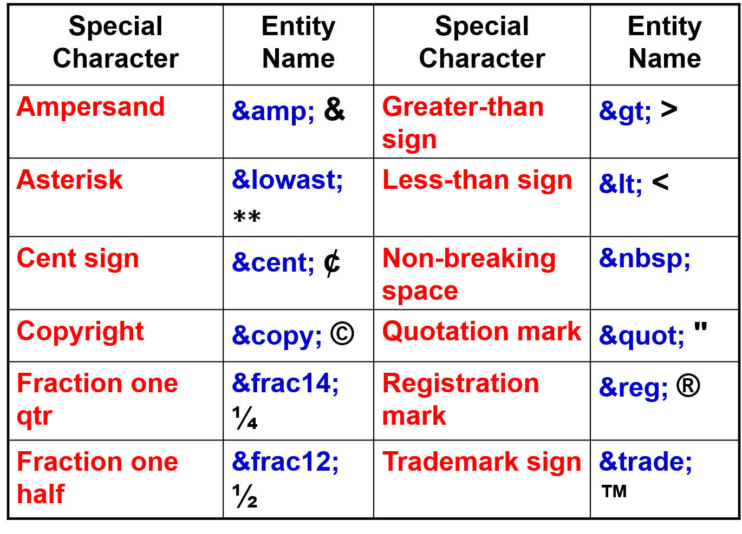
Special Characters & Symbols

Slide 22
List
<UL>
<LI> List item …</LI>
<LI> List item …</LI>
</UL>
<OLTYPE=“i” START=“3”>
<LI> List item …</LI>
<LI> List item …</LI>
</OL>
<UL TYPE = “square”>
<LI> List item …</LI>
<LI> List item …
<OL TYPE=“i” START=“3”>
<LI> List item …</LI>
<LI> List item …</LI>
<LI> List item …</LI>
<LI> List item …</LI>
<LI> List item …</LI>
</OL>
</LI>
<LI> List item …</LI>
</UL>

Slide 23
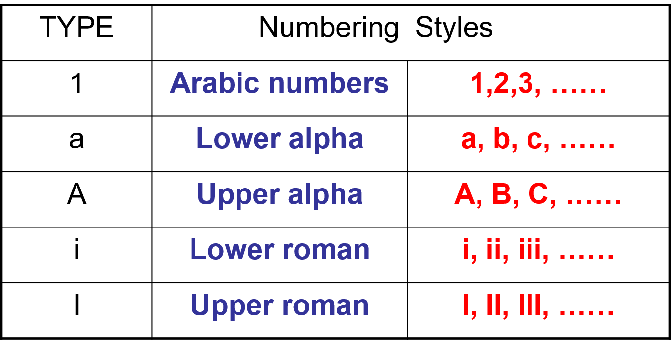
List Elements

Slide 24
Images
<IMG>This element defines a graphic image on the page.
<IMG SRC="image.ext" ALT="This is a text that goes alternate to the image" width="60" height="60" Hspace="30" Vspace="10" align="left" border=4>

Slide 25
Link
<a href="http://www.website.ext">Anchor Text</a>
<A HREF=“mailto:user@gmail.com”>Send me</A>

Slide 26
Outdated Tag Frame
<html>
<head>
<frameset cols=“25%,75%”>
<frame src=“doc1.html” noresize scrolling=no >
<frame src=“doc2.html”>
<NOFRAMES>
<P> This is a Framed Page.</P>
</NOFRAMES>
</frameset >
</head>
</html>

Slide 27
Forms
<BODY BGCOLOR=“FFFFFF”>
<FORM ACTION = “process.php”>
<INPUT TYPE=“TEXT” NAME=“fname” MAXLENGTH=“50”> <INPUT TYPE=“SUBMIT” NAME=“fsubmit1” VALUE=“Send Info”>
</FORM>
</BODY>

Slide 28
<INPUT> Element’s Properties
TYPE= Type of INPUT entry field.
NAME = Variable name passed to CGI application
VALUE= The data associated with the variable name to be passed to the CGI application
CHECKED= Button/box checked
SIZE= Number of visible characters in text field
MAXLENGHT= Maximum number of characters accepted.

Slide 29
<BODY>
<FORM name="fome1" Method= " get " Action= " URL " >
First Name: <INPUT TYPE="TEXT" NAME="FName"
SIZE="15" MAXLENGTH="25"><BR>
Last Name: <INPUT TYPE="TEXT" NAME="LName"
SIZE="15" MAXLENGTH="25"><BR>
Nationality: <INPUT TYPE="TEXT" NAME="Country"
SIZE="25" MAXLENGTH="25"><BR>
The Phone Number: <INPUT TYPE="TEXT" NAME="Phone"
SIZE="15" MAXLENGTH="12"><BR>
</FORM>
</BODY>

Slide 30
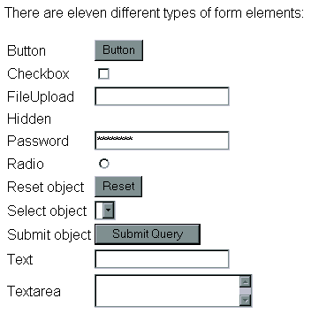
All elements

Slide 31
New Elements in HTML5
<article>
<aside>
<audio>
<canvas>
<datalist>
<figure>
<figcaption>
<footer>
<header>
<hgroup>
<mark>
<nav>
<progress>
<section>
<source>
<svg>
<time>
<video>
These are just some of the new elements introduced in HTML5. We will be exploring each of these during this course.

Slide 32
Other New Features in HTML5
Built-in audio and video support (without plugins)
Enhanced form controls and attributes
The Canvas (a way to draw directly on a web page)
Drag and Drop functionality
Support for CSS3 (the newer and more powerful version of CSS)
More advanced features for web developers, such as data storage and offline applications.

Slide 33
First Look at HTML5
Remember the DOCTYPE declaration from XHTML?
<!DOCTYPE html PUBLIC "-//W3C//DTD XHTML 1.0 Transitional//EN"
"http://www.w3.org/TR/xhtml1/DTD/xhtml1-transitional.dtd">
In HTML5, there is just one possible DOCTYPE declaration and it is simpler:
<!DOCTYPE html>
Just 15 characters!
The DOCTYPE tells the browser which type and version of document to expect. This should be the last time the DOCTYPE is ever changed. From now on, all future versions of HTML will use this same simplified declaration.

Slide 34
Basic HTML5 Web Page
Putting the prior sections together, and now adding the <body> section and closing tags, we have our first complete web page in HTML5:
<!DOCTYPE html>
<html lang="en">
<head>
<meta charset="utf-8">
<title>My First HTML5 Page</title>
<link rel="stylesheet" href="style.css">
</head>
<body>
<p>HTML5 is fun!</p>
</body>
</html>
Even though we used HTML5, the page looks the same in a web browser as it would in XHTML. Without looking at the source code, web visitors will not know which version of HTML the page was created with.
Let's open this page in a web browser to see how it looks…

Slide 35
Thanks
In case of any assistance,
please feel free to contact us at
info@careerera.com

